Slide 1

ANALYZING THE ACCURACY OF AI DETECTORS WITH CHATGPT: FINDING THE BEST SOLUTIONS
BY
STEVEN CARTWRIGHT, RYAN DEMOLINA, AND IAN DELANO

Slide 2

ISSUE:
With this rise of AI writing services such as ChatGPT, it is harder and harder for instructors to determine if a student’s writing is authentic. There are many AI writing detectors, but no way to tell which are the most effective. Our study will determine what services instructors should be using to detect AI written content, while avoiding false positives.

Slide 3
INITIAL DESIGN AND ISSUES
Finding APIs for checkers was a significant issue. Only Writer.com has a free trial, and for the others we were forced to use web-scraping.
We initially planned to do the same analysis for plagiarism detectors as well, but there were none with free APIs and nearly all of them had safeguards against web-scraping.
We had to take extra care to ensure that our project would benefit instructors and institutions in the fight against AI-written assignments.

Slide 4




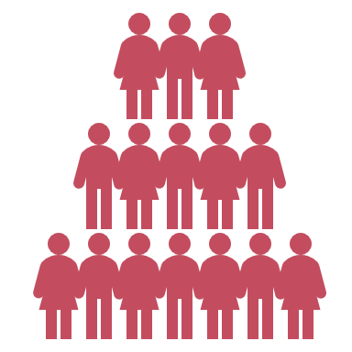


ABSTRACT OF PROJECT
1. Capstone project uses ChatGPT in OpenAI API.
2. Goal: Determine most effective AI-writing detection services.
3. Generating mini essays with various topics and tones.
4. Inputting essays into all AI detection services, as well as human-written control groups.
5. Compare services' overall and subgroup performance.
6. Used statistical analysis (averaging, distribution) and algorithms.
7. Procedure: Generate essays, input into checkers, analyze results.

Slide 5
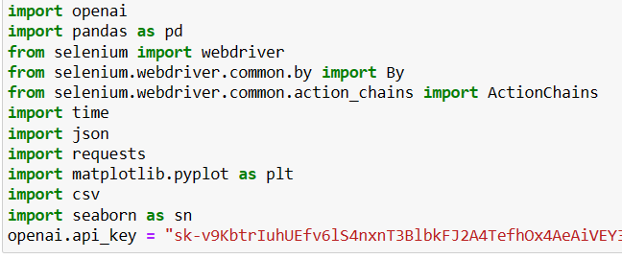
IMPORTS NEEDED FOR OUR CODE
1. Import openai library for accessing OpenAI API.
2. Import pandas library for data manipulation and analysis.
3. Import webdriver from selenium for web automation.
4. Import By from selenium.webdriver.common.by to search for web elements.
5. Import ActionChains from selenium.webdriver.common.action_chains for user actions on the web page.
6. Import time for handling time-related operations.
7. Import json for working with JSON data.
8. Import requests for sending HTTP requests.
9. Import matplotlib.pyplot as plt for data visualization.
10. Import csv for working with CSV files.
11. Set OpenAI API key for authentication.

Slide 6
CODE
CHECKER FUNCTIONS
Optimally, all checkers would have free APIs to utilize to efficiently generate essay scores
This is true for Writer.com, which offers a free trial for its API.
However, none of the other programs offered one, forcing us to resort to web scraping to generate scores.
As a result, the Writer.com checker code is shorter and more simple than the others, demonstrating the effectiveness of APIs.

Slide 7
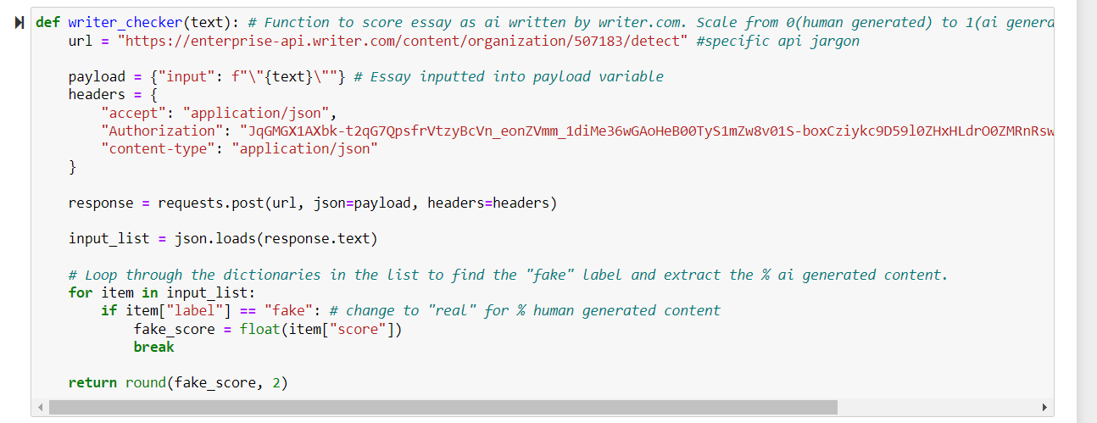
WRITER_CHECKER - EXAMPLE OF API UTILIZATION
1. Defines function to score an essay as AI or human-generated.
2. API endpoint URL is specified for the API request.
3. Essay text is passed in as an input and set as a payload.
4. API request is made using requests.post() method and response is received.
5. The function returns the percentage of AI-generated content rounded to two decimal places.

Slide 8
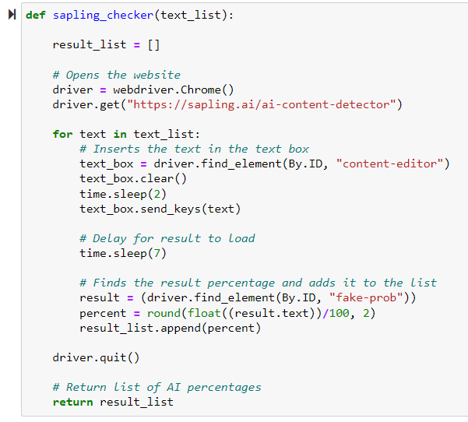
SAPLING.AI CHECKER - EXAMPLE OF WEBSCRAPING UTILIZATION
- Function to check text score on sapling.ai
- Uses Selenium and Chrome webdriver
- Inputs text into text box
- Extracts score percentage from results
- Returns list of scores for each text input.

Slide 9
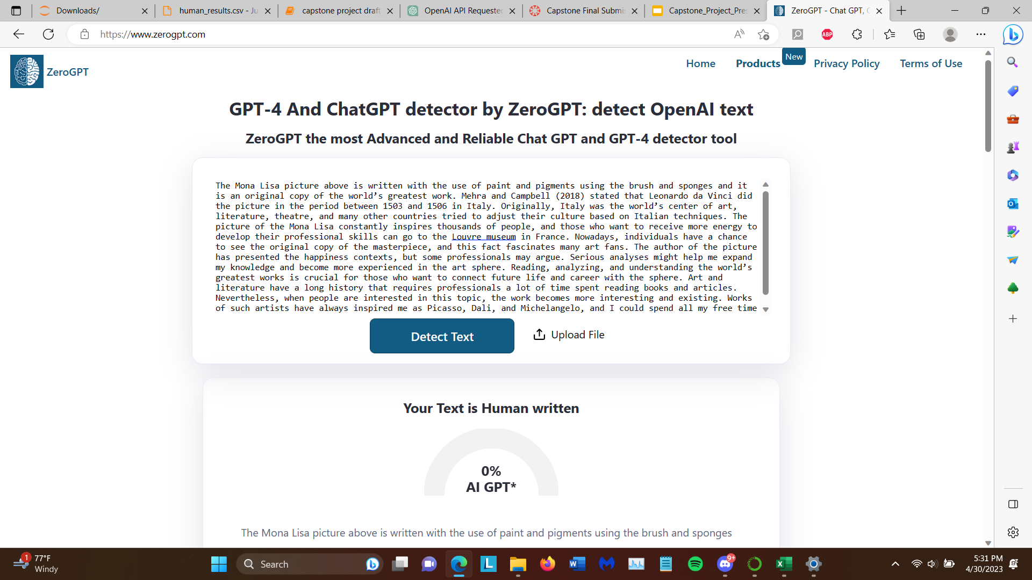
EXAMPLE OF AI DETECTION PROGRAM TO WEBSCRAPE (ZEROGPT)
-Paste essay into box
Click “Detect Text” Button
Scrape “x”% AI GPT value for score

Slide 10
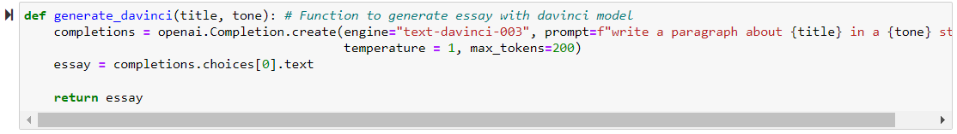
DAVINCI GENERATION THROUGH OPENAI API
- Utilize OpenAI’s API to generate essays
- Uses OpenAI's Davinci model
- Takes a title and tone as input
- Generates a paragraph about the title
- Outputs the generated essay

Slide 11
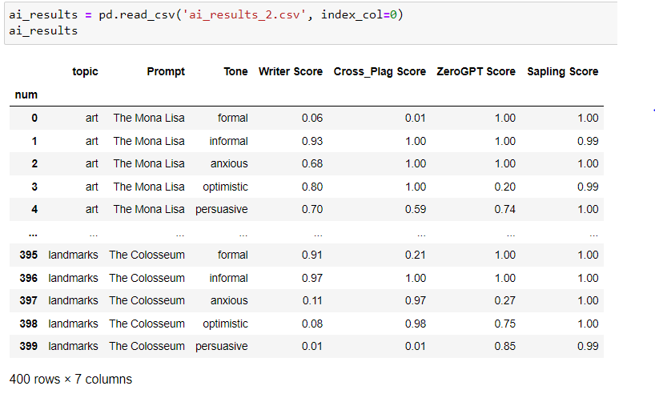
RESULTS

Slide 12
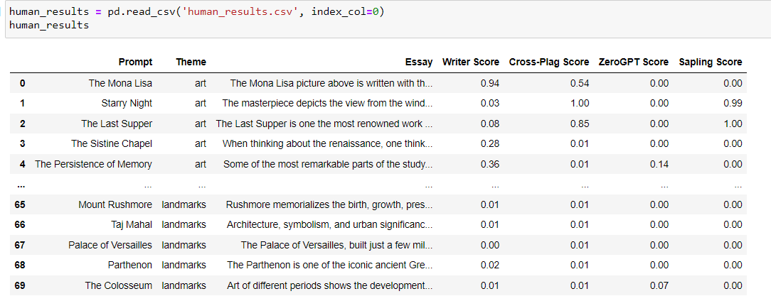
SCORES OF HUMAN WRITTEN ESSAYS

Slide 13
DISPLAY AND INTERPRETATION OF RESULTS
At this point, we have two csv files: One of the results of human generated essays, and one of the results of AI generated essays
Now, we need to display these results graphically so they can be interpreted
In order to do this, we created an interactive graphing program to generate any graph the user desires with our data

Slide 14
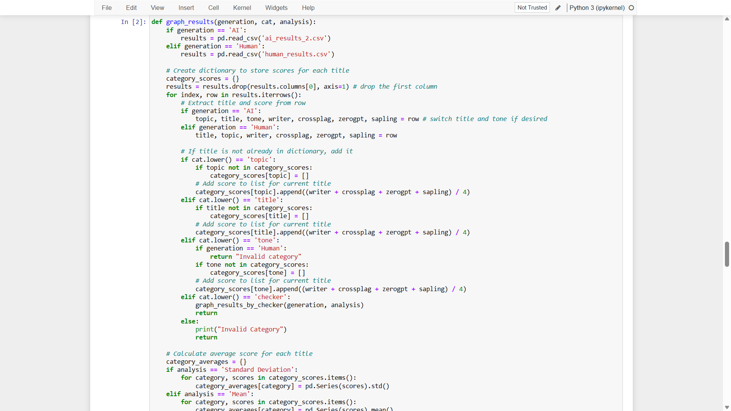
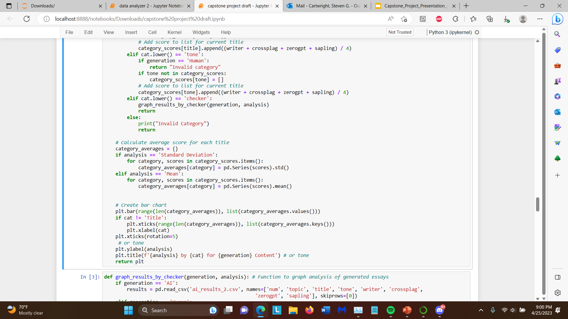
GRAPH RESULTS METHOD
This method creates unique graphs based on the type of generation (AI or human), category to analyze by (topic, title, tone, checker), and type of analysis to do (mean, standard deviation)

Slide 15
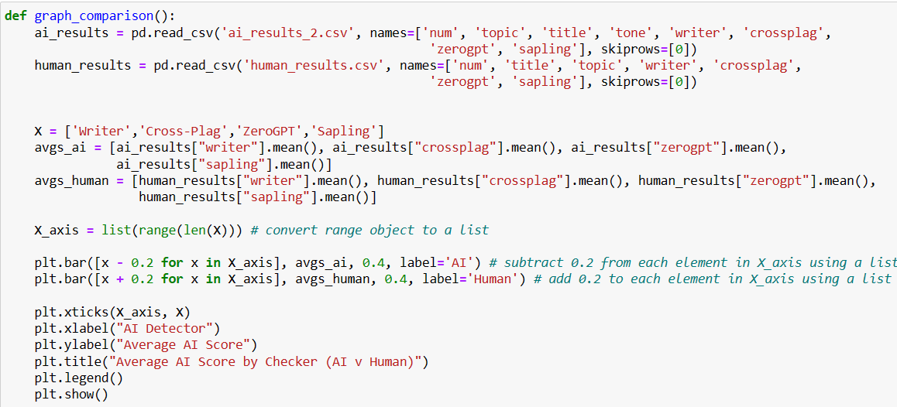
GRAPH COMPARISON
This method creates a graph to compare the mean scores of each checker for AI and human content. This is a great graph to analyze overall effectiveness of each checker.

Slide 16
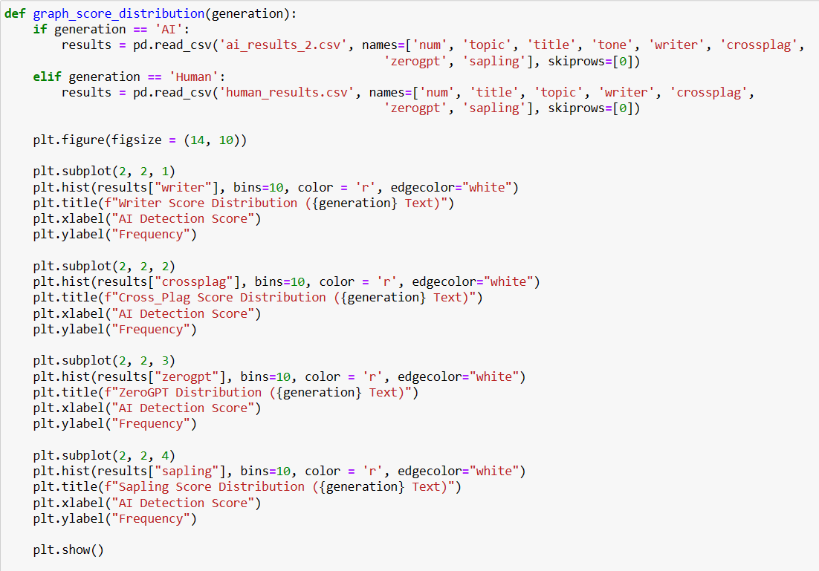
GRAPH SCORE DISTRIBUTION
This demonstrates the subplot feature of matplotlib, creating score distribution graphs of each checker for either human or AI content.
This graph is a way to get a feel of what types of scores the checkers tend to produce.
While all the checkers are fairly binary, producing 0s and 1s frequently, some produced more values in the middle.

Slide 17
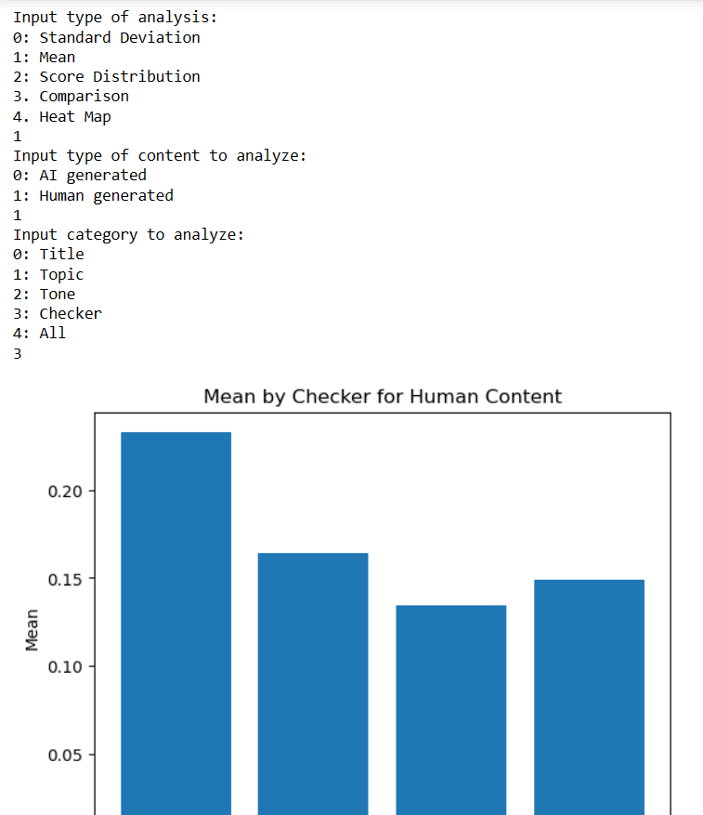
INTERACTIVE GRAPHING METHOD
Example of utilization of method.
User inputs type of analysis, and then other criteria such as content type and category to specify graph.
Generated graph is returned.

Slide 18
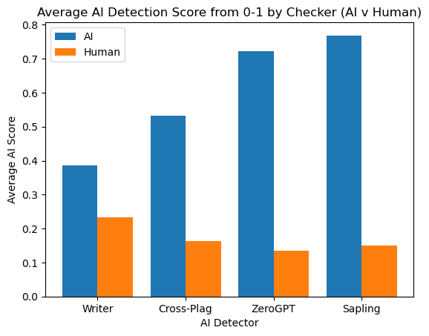
RESULTS

Slide 19
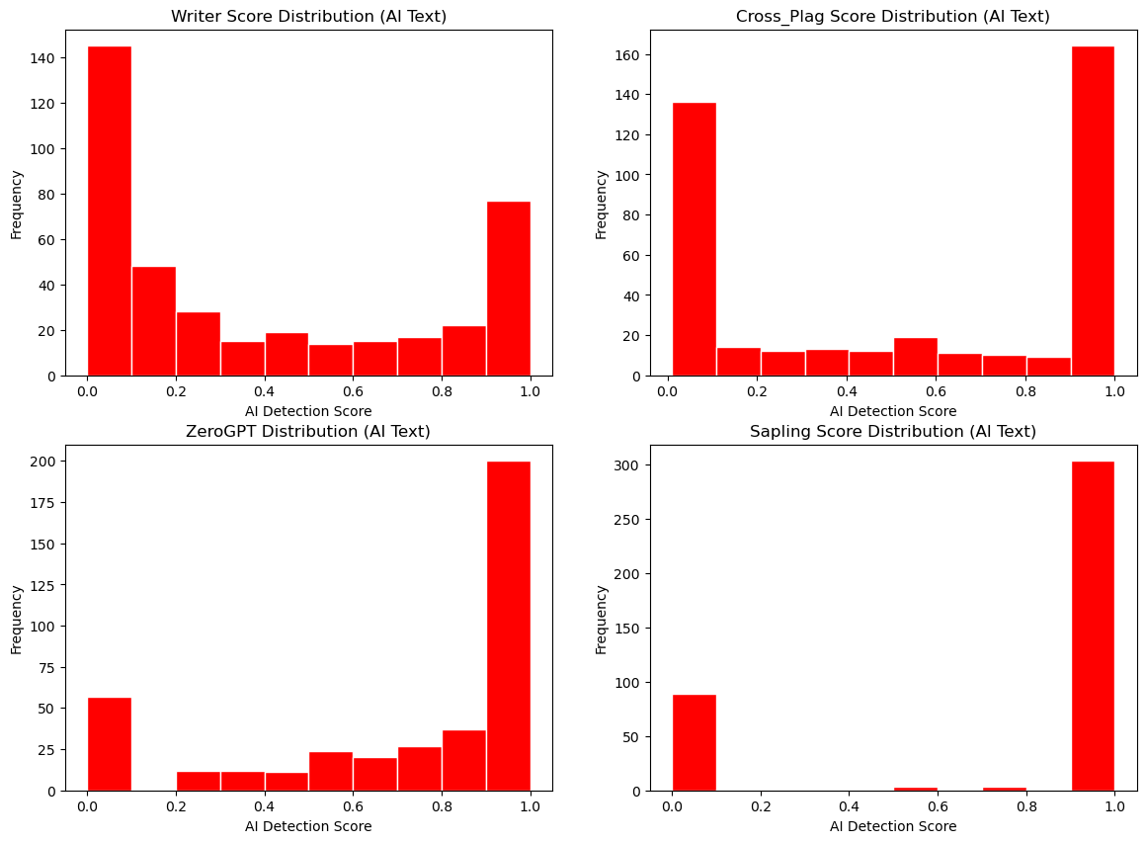
AI SCORE DISTRIBUTION
Lack of scores in the middle of the spectrum indicates a more ‘binary’ checker, which generally assigns values close to 0 or close to 1.
The desired outcome is a higher bar on the right, and lower bar on the left. Because of this, ZeroGPT and Sapling are the best.

Slide 20
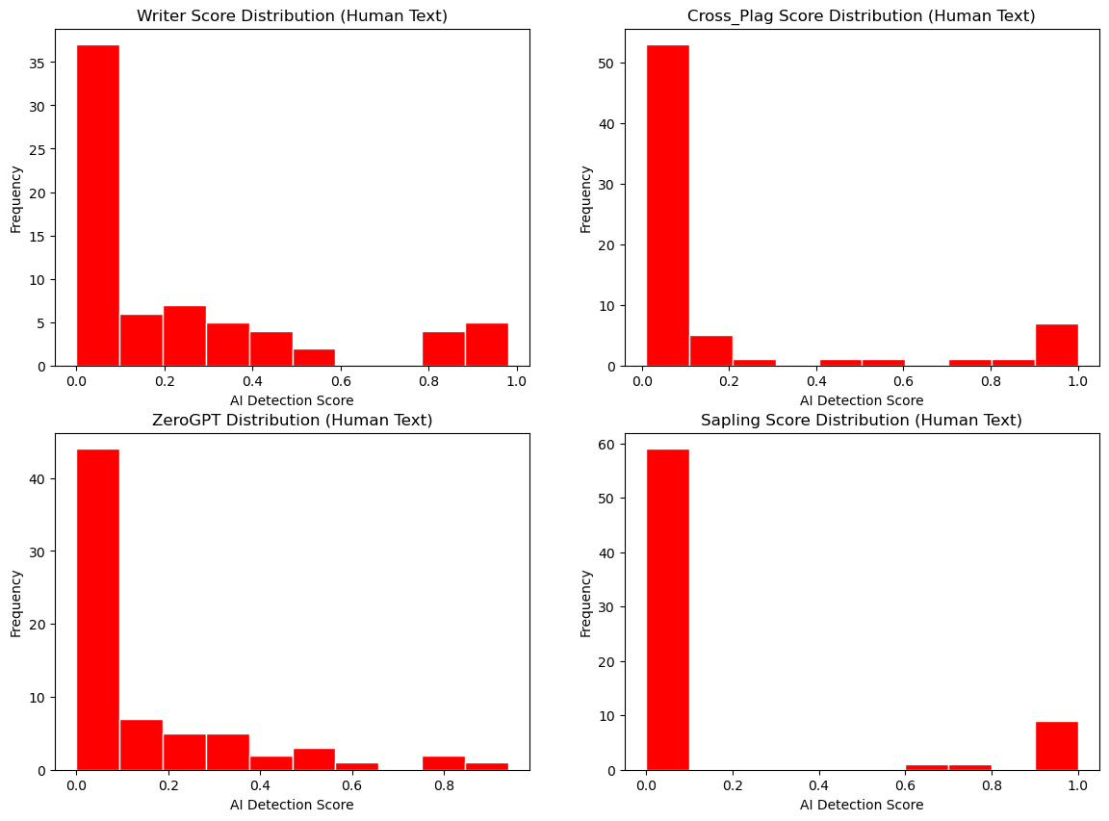
HUMAN SCORE DISTRIBUTION

Slide 21
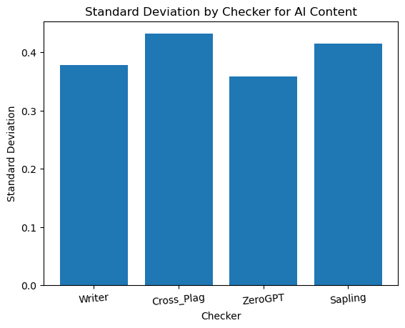
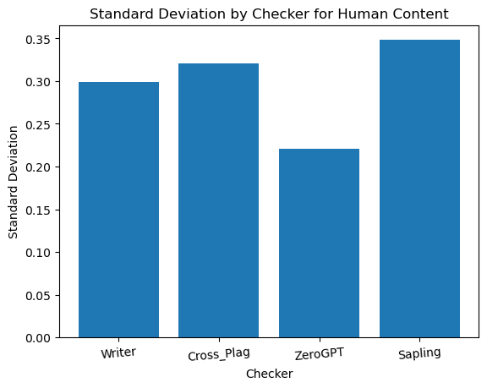
STANDARD DEVIATION

Slide 22
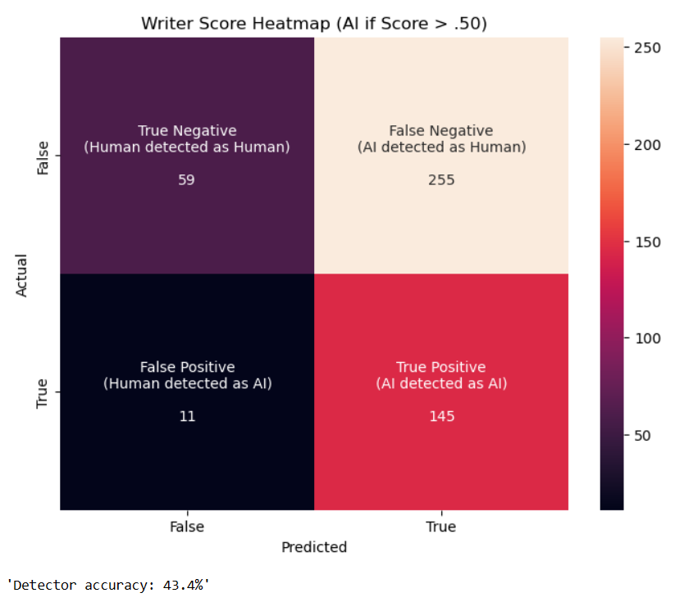
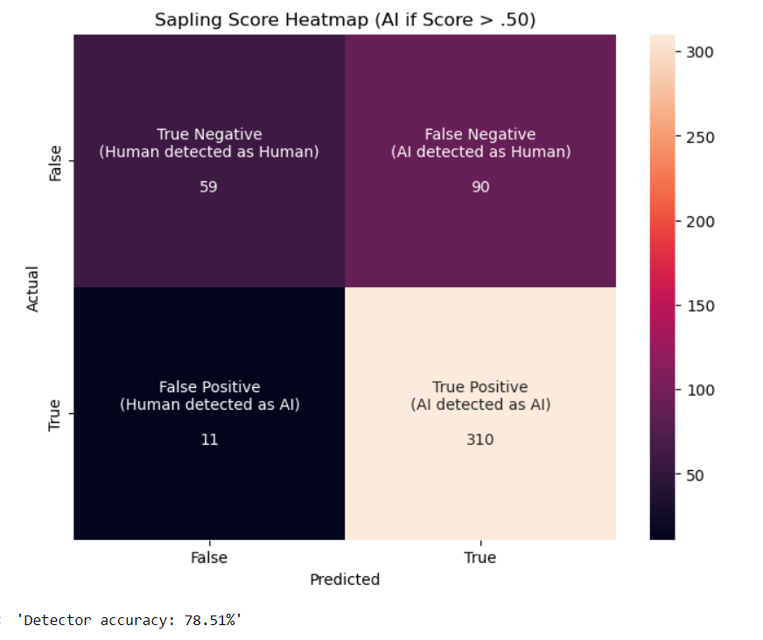
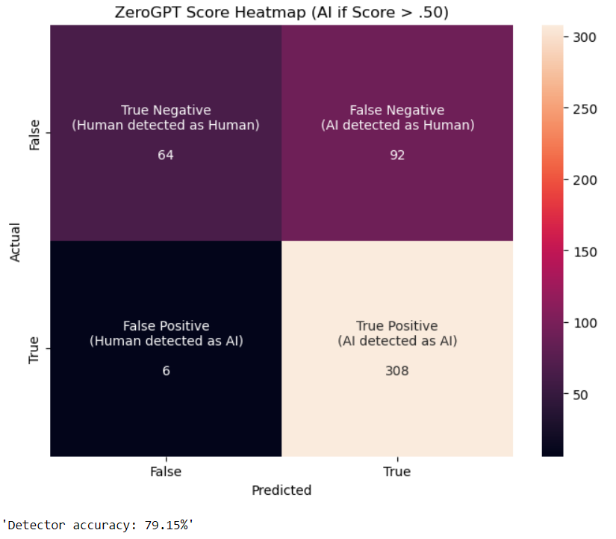
HEAT MAPS: WARMER COLOR = HIGHER RATE

Slide 23
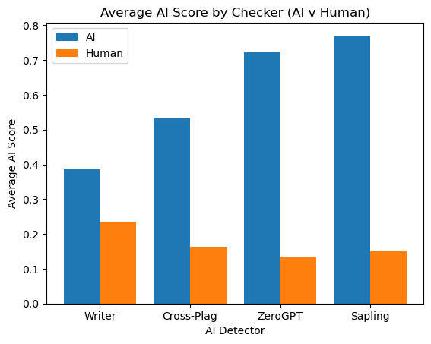
RESULTS
ZeroGPT and Sapling perform far more effectively than Writer and Cross_Plag.
The severe underperformance of Writer is surprising, as it has an available API and is the first one to show up on Google.
While Sapling has a slightly higher rate of detection for AI content than ZeroGPT, it also has a substantially higher false positive rate (see heat maps and score distribution).
False positives are extremely problematic because they can result in students getting unfairly accused of using AI.
Because of this, we conclude that ZeroGPT is the best AI writing detector for the davinci model.

Slide 24

CONCLUSION
To combat the increasing issue of AI-generated assignments, teachers should show discretion when choosing an AI content detector, as the most popular (Writer.com) may not be the best.
We have concluded that ZeroGPT is the best detector, showing impressive detection rates while avoiding false positives
Yet, it should still not be blindly trusted, as even this detector has not been developed to the point where it can avoid false positives entirely.

Slide 25
LIMITATIONS
Our original goal was to use both the davinci and GPT-3.5 models for text generation. However, the GPT-3.5 model could only generate 3 responses per minute, so we had to remove it from our analysis.
The checkers that use web scraping and automation take quite some time to run, so the number of data points we could collect was limited due to time.
The list of prompts and tones is not comprehensive, so our analysis may be limited by the types of responses generated.

Slide 26
REFERENCES
https://platform.openai.com/
https://writer.com/product/api/
https://crossplag.com/ai-content-detector/
https://www.zerogpt.com/
https://sapling.ai/ai-content-detector
https://www.selenium.dev/documentation/webdriver/
https://ivypanda.com/essays/
https://datatofish.com/confusion-matrix-python/

